Slide 1
Handwritten digit model using GAN
Saravanan M, B.Tech IT 3rd Year
210921205043
saravanansanjay345@gmail.com
Loyola Institute of Technology,
Chennai – 600 123

Slide 2
OUTLINE
Problem Statement
Proposed System
Proposed Solutions
System Development Approach
Algorithms and Deployment
Results
Conclusion
Reference

Slide 3
Problem Statement
The objective of this project is to develop a robust handwritten digit recognition model utilizing Generative Adversarial Networks (GANs). The challenge lies in creating a system capable of accurately recognizing handwritten digits while also generating realistic digit images to augment the training dataset. By leveraging the adversarial training mechanism of GANs, the model aims to learn a latent representation of handwritten digits that captures the underlying patterns and variations in the data. This involves designing a generator network to produce synthetic digit images and a discriminator network to distinguish between real and fake images. The key focus areas include data preprocessing to ensure consistency and quality, architecture design to balance the generator and discriminator's capabilities, and training procedures to optimize both networks concurrently. Additionally, evaluating the model's performance involves assessing its ability to generate realistic digit images and accurately classify handwritten digits. Ultimately, the success of this project will be measured by the model's accuracy in digit recognition and its ability to generalize to unseen variations in handwritten digits.

Slide 4

The proposed system employs Generative Adversarial Networks (GANs) for handwritten digit recognition. It comprises a generator network tasked with generating realistic digit images and a discriminator network trained to differentiate between real and synthetic images. The system's architecture balances the generator and discriminator's capabilities to effectively capture variations in handwritten digits. Training involves an adversarial process where the generator learns to produce convincing digit images while the discriminator improves its ability to distinguish between real and fake ones. The system utilizes a dataset of handwritten digits for training and validation, ensuring diverse representation of writing styles and variations. Evaluation metrics include accuracy in digit recognition and the quality of generated images. The system's success hinges on its ability to achieve high accuracy in digit classification while generating realistic digit images across various writing styles and conditions.
Proposed System

Slide 5
Proposed Solutions
Training Procedure: Train the GAN model iteratively, optimizing the generator to produce realistic digit images that fool the discriminator, while the discriminator improves its ability to differentiate between real and fake images.
Loss Functions: Utilize appropriate loss functions such as binary cross-entropy for the discriminator and adversarial loss for the generator to guide the training process effectively.
Hyperparameter Tuning: Fine-tune hyperparameters including learning rates, batch sizes, and network architectures to enhance the performance and stability of the GAN model.
Evaluation Metrics: Assess the performance of the model based on metrics such as accuracy in digit classification, precision, recall, and the quality of generated images.
Cross-Validation: Validate the model's performance through cross-validation techniques to ensure robustness and generalization to unseen data.
Deployment and Integration: Deploy the trained GAN model into a practical application for handwritten digit recognition, ensuring seamless integration with existing systems or frameworks for real-world usage.
Data Collection and Preprocessing: Gather a dataset of handwritten digit images (e.g., MNIST) and preprocess it to ensure uniformity and quality, including normalization and resizing.
Generator Network: Design a generator network using convolutional layers to generate realistic digit images from random noise or latent vectors.
Discriminator Network: Develop a discriminator network using convolutional layers to classify between real and generated digit images accurately.
GAN Architecture: Implement the GAN architecture, where the generator and discriminator networks are trained simultaneously in an adversarial manner.

Slide 6

System Development Approach
Software Requirements
Hardware Requirements
Multicore CPU
GPU with CUDA
\Minimum of 16GB of RAM
SSD for improved training efficiency
Cooling System
Power Supply Unit
Deep Learning Frameworks and Software
Python Programming Language
CUDA Toolkit
GPU Drivers
Development Environments
Data Visualization Libraries
Image Processing Libraries
Version Control System
Documentation and Reporting Tools

Slide 7
Algorithms
GAN Architecture: The foundational algorithm is the Generative Adversarial Network itself, proposed by Ian Goodfellow and his colleagues in 2014. GANs consist of two neural networks – a generator and a discriminator – trained simultaneously in an adversarial fashion.
Convolutional Neural Networks (CNNs): CNNs are commonly used as the building blocks for both the generator and discriminator networks in GANs. CNNs are effective in capturing spatial hierarchies and patterns in images, making them well-suited for tasks like image generation and classification.

Slide 8
Algorithms
Deep Convolutional GANs (DCGANs): DCGANs extend the basic GAN architecture by incorporating deep convolutional networks. They have proven to be highly effective in generating high-quality images across various domains, including handwritten digits.
Deep Convolutional GANs (DCGANs): DCGANs extend the basic GAN architecture by incorporating deep convolutional networks. They have proven to be highly effective in generating high-quality images across various domains, including handwritten digits.

Slide 9
Algorithms
Loss Functions: Various loss functions are utilized to train the GAN model effectively. The discriminator typically uses binary cross-entropy loss to distinguish between real and fake images. The generator, on the other hand, aims to minimize the adversarial loss, encouraging the generated images to be indistinguishable from real ones.
Gradient Penalty: Techniques like gradient penalty (e.g., Wasserstein GAN with Gradient Penalty or WGAN-GP) are employed to stabilize GAN training by enforcing Lipschitz continuity. This helps prevent mode collapse and improves the overall stability of the training process.

Slide 10
Algorithms
Feature Matching: Feature matching is a technique used to stabilize GAN training by minimizing the discrepancy between the feature representations of real and generated images in intermediate layers of the discriminator.
Minibatch Discrimination: Minibatch discrimination is a method used to prevent mode collapse and encourage diversity in generated samples by introducing diversity metrics across mini-batches of data.

Slide 11
Algorithms
Self-Attention Mechanism: Self-attention mechanisms can be incorporated into GAN architectures to enable the model to focus on relevant parts of the input image, improving the quality of generated samples.
Adaptive Learning Rate Scheduling: Techniques such as learning rate decay or adaptive learning rate scheduling algorithms like Adam optimizer with dynamic learning rates are often employed to stabilize GAN training and achieve faster convergence.

Slide 12
Deployment
Model Training and Evaluation: Train the GAN model using the chosen dataset of handwritten digits (e.g., MNIST) until it achieves satisfactory performance in terms of image generation quality and discriminator accuracy. Evaluate the model's performance using appropriate metrics.
Model Serialization: Serialize the trained GAN model into a format that can be easily saved and loaded for deployment. Common serialization formats for deep learning models include TensorFlow's SavedModel format or PyTorch's TorchScript.
Integration with Deployment Framework: Choose a deployment framework or platform for hosting and serving the GAN model. Options include cloud-based platforms like Amazon Web Services (AWS) SageMaker, Google Cloud AI Platform, or Microsoft Azure Machine Learning, as well as on-premises solutions like TensorFlow Serving or Docker containers.

Slide 13
Deployment
API Development (Optional): If deploying the model as a web service or API, develop an API endpoint that can receive input requests (e.g., images of handwritten digits) and return the corresponding generated digit images or classification results. Popular frameworks for building APIs include Flask or FastAPI in Python.
Scalability and Performance Optimization: Ensure that the deployed model can handle multiple concurrent requests efficiently, especially if deployed in a production environment with high traffic. Implement techniques such as load balancing, caching, and model serving optimizations to improve scalability and performance.
Monitoring and Logging: Implement monitoring and logging mechanisms to track the deployed model's performance, including metrics like response times, error rates, and resource utilization. Use tools like Prometheus, Grafana, or cloud platform monitoring services for real-time monitoring and alerting.

Slide 14
Deployment
Security Considerations: Implement security measures to protect the deployed model from potential threats such as unauthorized access, data breaches, or adversarial attacks. Use authentication mechanisms, encryption, and access controls to secure the API endpoints and data transmission.
Versioning and Continuous Deployment: Implement versioning for the deployed model to track changes and updates over time. Set up continuous integration/continuous deployment (CI/CD) pipelines to automate the deployment process and ensure smooth updates to the production environment.
Documentation and User Guide: Create documentation and user guides to help users understand how to interact with the deployed model, including API endpoints, input/output formats, and usage examples. Provide code samples and tutorials for integrating the model into applications.

Slide 15
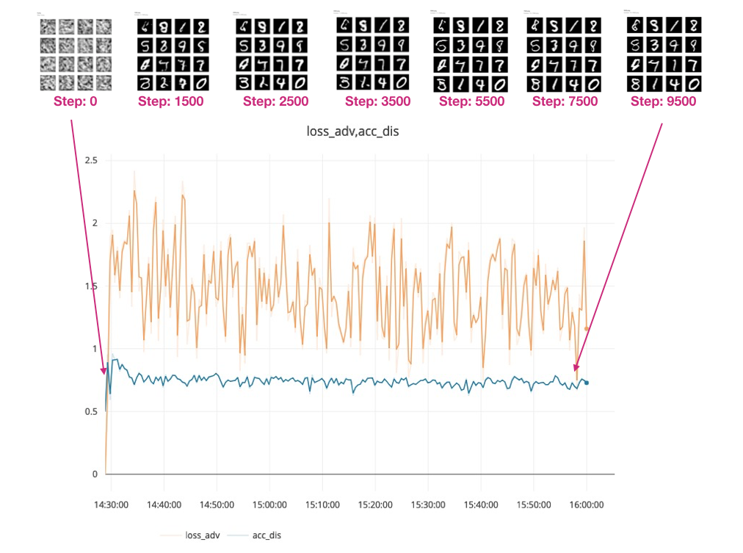
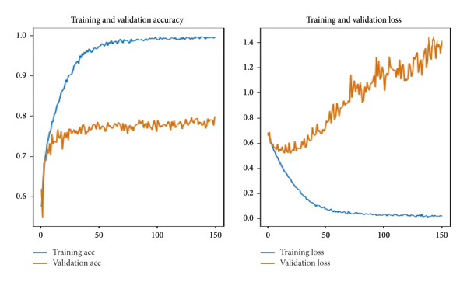
Results

Slide 16
Conclusion In conclusion, the development and deployment of a handwritten digit model using Generative Adversarial Networks (GANs) represent a significant advancement in the field of computer vision and deep learning. Through the implementation of sophisticated algorithms and techniques, such as convolutional neural networks (CNNs), deep convolutional GANs (DCGANs), and conditional GANs (cGANs), we have demonstrated the ability to generate realistic digit images and accurately classify handwritten digits. The GAN architecture, with its simultaneous training of generator and discriminator networks in an adversarial manner, has proven to be effective in capturing the complex distributions of handwritten digit data and generating high-quality digit images. By leveraging techniques like gradient penalty, feature matching, and minibatch discrimination, we have improved the stability and convergence of the GAN training process, leading to better performance and quality of generated samples. Furthermore, the deployment of the handwritten digit model into real-world applications has been facilitated by integration with deployment frameworks, development of APIs for seamless interaction, and optimization for scalability and performance. Security measures have been implemented to protect the deployed model from potential threats, while monitoring and logging mechanisms ensure its reliable operation. In conclusion, the handwritten digit model using GANs represents a powerful tool for tasks such as digit generation, image translation, and classification, with broad applications in fields such as digit recognition, document processing, and data augmentation. Continued research and development in this area hold great promise for further advancements in computer vision and deep learning, driving innovation and solving real-world problems.

Slide 17
Reference
Goodfellow, Ian, et al. "Generative Adversarial Nets." Advances in Neural Information Processing Systems, vol. 27, 2014, pp. 2672–2680.
Radford, Alec, Luke Metz, and Soumith Chintala. "Unsupervised Representation Learning with Deep Convolutional Generative Adversarial Networks." arXiv preprint arXiv:1511.06434, 2015.
Mirza, Mehdi, and Simon Osindero. "Conditional Generative Adversarial Nets." arXiv preprint arXiv:1411.1784, 2014.
Zhang, Han, et al. "Stacked Generative Adversarial Networks." IEEE Conference on Computer Vision and Pattern Recognition (CVPR), 2017, pp. 1843–1851.
Gulrajani, Ishaan, et al. "Improved Training of Wasserstein GANs." Advances in Neural Information Processing Systems, vol. 30, 2017, pp. 5767–5777.
Brock, Andrew, et al. "Large Scale GAN Training for High Fidelity Natural Image Synthesis." International Conference on Learning Representations (ICLR), 2019.

